Slide 1
FORTRAN 95/2003 For Engineers
Charge Number – SJSAX00TDG
Course Number – 205335ILT00
Instructor – Mike Worthey
Phone – 3-2434
email – mike.k.worthey@lmco.com

Slide 2
Course Outline
A Brief History of FORTRAN
Basic Elements
Program Design and Branching Structures
Loops and Character Manipulation
Basic I/O Concepts
Introduction to Arrays
Introduction to Procedures
Additional Features of Arrays
Additional Features of Procedures
More about Character Variables
Additional Intrinsic Data Types
Derived Data Types
Advanced Features of Procedures and Modules
Advanced I/O Concepts
Pointers and Dynamic Data Structures
Object-Oriented Programming in FORTRAN
Redundant, Obsolescent, and Deleted FORTRAN Features

Slide 3
A Brief History of FORTRAN

Slide 4

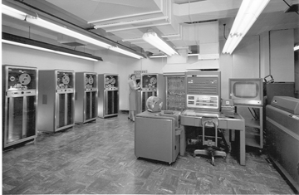
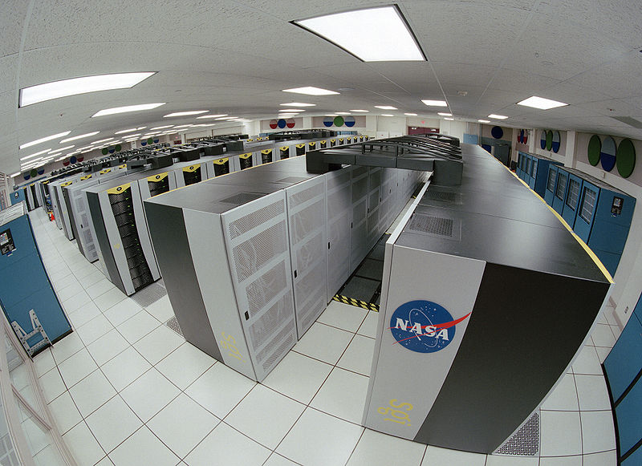
Digital Computers
Computers are probably the most important inventions of the 20th Century.
The first digital computer came online in May of 1941 in Germany.
The first US digital computer came online in 1942.
IBM 704 Mainframe
Columbia Super Computer at NASA Ames

Slide 5
What is a Computer
What is a computer ?
A special machine that stores information and manipulates data according to a set of instructions called a program.
Input Devices
Output Devices
Internal memory (registers)
Control Unit
Arithmetic Logic Unit
Central Processing Unit
Main Memory
Secondary Memory

Slide 6
Computer Components
The CPU
Control Unit – Controls all other parts of the computer
Arithmetic logic unit – Performs the actual mathematical calculations
Internal memory – Used for temporary storage of intermediate results
Main and Secondary Memory
Main memory –
Consists of very fast and expensive semiconductor chips
Used for temporary storage of the program and data currently being executed.
Volatile – memory erased whenever power is turned off.
Secondary memory –
Slower and cheaper than main memory
Non-volatile
Typical examples are Hard Drives, USB Thumb drives, Floppy disks, CD’s and DVDs.
Normally used to store programs and data that are not needed at the moment

Slide 7
Computer Components
Input and Output Devices
Input Devices –
Allows data and programs to be input
Examples: Keyboard, Mouse, Scanner, Camera, Microphone,
Output Devices –
Allows us to used the data stored on the computer
Examples: Printers, Monitor, Speakers, Plotters

Slide 8
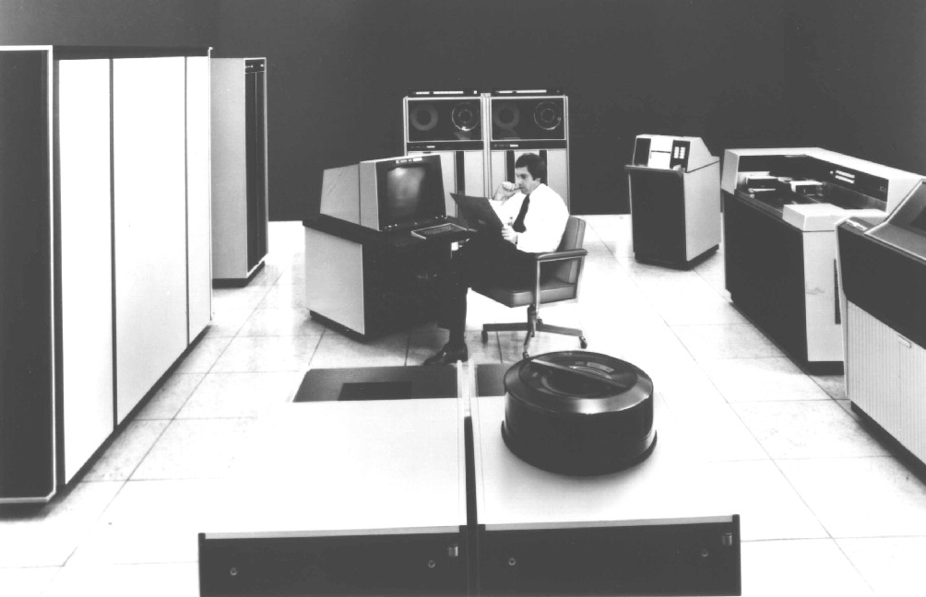
CYBER 175
Tape Drive: Secondary Memory
Monitor: Output
Card Reader: Input
CPU and Main Memory
Keyboard: Input
Printer: Output
Hard Drive: Secondary Memory

Slide 9
Computer Data Representation
Computer Memories composed of billions of individual on/off switches
Each switch represents one binary digit or bit
On-state interpreted as a binary 1
Off-state interpreted as a binary 0
When grouped together these bits can represent numbers in the binary number system (base 2)
Byte
Smallest Common grouping
Group of 8 bits that are used together to represent a binary number.
Word
Next larger grouping
Consists of 2, 4 or more consecutive bytes that are used to represent a single number in memory.

Slide 10
Interfacing with Computers
While computers work in the binary system, people think in the decimal system.
High level computer languages like FORTRAN and C were developed as a means to simplify the task of programming.
Sometimes, however, we have to work directly with the binary representations coded on the computer.

Slide 11
What is a Program ?
A program is a series of instructions executed by the computer.
Running a computer code:
When computers execute a program, they are really executing a string of very simple operations such as: load, store, add, subtract, etc.
Each operation has a unique binary pattern called an operation code (op code). These are collectively called machine language.
Compilers are special programs that convert high-level program languages to a lower level program language

Slide 12
Early Development
In late 1953, John W. Backus submitted a proposal to his superiors at IBM to develop a more efficient alternative to assembly language for programming their IBM 704 mainframe computer. Backus' historic FORTRAN team consisted of programmers Richard Goldberg, Sheldon F. Best, Harlan Herrick, Peter Sheridan, Roy Nutt, Robert Nelson, Irving Ziller, Lois Haibt and David Sayre.
A draft specification for The IBM Mathematical Formula Translating System was completed by mid-1954 with the first FORTRAN compiler delivered in April 1957. This was an optimizing compiler, because customers were reluctant to use a high-level programming language unless its compiler could generate code whose performance was comparable to that of hand-coded assembly language.
The new method reduced the amount of programming statements necessary to operate a machine by a factor of 20, and quickly gained acceptance. Said creator John Backus during a 1979 interview, "Much of my work has come from being lazy. I didn't like writing programs, and so, when I was working on the IBM 701 (an early computer), writing programs for computing missile trajectories, I started work on a programming system to make it easier to write programs."
The language was widely adopted by scientists for writing numerically intensive programs. The inclusion of a complex number data type in the language made Fortran especially suited to technical applications.
By 1960, versions of FORTRAN were available for the IBM 709, 650, 1620, and 7090 computers. By 1963 over 40 FORTRAN compilers existed. FORTRAN is considered to be the first widely used programming language supported across a variety of computer architectures.

Slide 13
Early FORTRAN
The initial release (1957) of FORTRAN for the IBM 704 contained 32 statements, including:
DIMENSION and EQUIVALENCE statements
Assignment statements
Three-way arithmetic IF statement.
IF statements for checking exceptions and IF statements for manipulating sense switches and sense lights
GOTO, computed GOTO, ASSIGN, and assigned GOTO
DO loops
Formatted I/O: FORMAT, READ, READ INPUT TAPE, WRITE, WRITE OUTPUT TAPE, PRINT, and PUNCH
Unformatted I/O: READ TAPE, READ DRUM, WRITE TAPE, and WRITE DRUM
Other I/O: END FILE, REWIND, and BACKSPACE
PAUSE, STOP, and CONTINUE
FREQUENCY statement (for providing optimization hints to the compiler)
IBM's FORTRAN II appeared in 1958. The main enhancement was to support procedural programming by allowing user-written subroutines and functions. Six new statements were introduced:
SUBROUTINE, FUNCTION, and END
CALL and RETURN
COMMON
Over the next few years, FORTRAN II would also add support for the DOUBLE PRECISION and COMPLEX data types.

Slide 14
FORTRAN 66
Perhaps the most significant development in the early history of FORTRAN was the decision by the American Standards Association (now ANSI) to form a committee to develop an "American Standard Fortran.”
Known as FORTRAN 66, this version effectively became the first "industry-standard" version of FORTRAN.
FORTRAN 66 included:
Main program, SUBROUTINE, FUNCTION, and BLOCK DATA program units
INTEGER, REAL, DOUBLE PRECISION, COMPLEX, and LOGICAL data types
COMMON, DIMENSION, and EQUIVALENCE statements
DATA statement for specifying initial values
Intrinsic and EXTERNAL (e.g., library) functions
Assignment statement
GOTO, assigned GOTO, and computed GOTO statements
Logical IF and arithmetic (three-way) IF statements
DO loops
READ, WRITE, BACKSPACE, REWIND, and ENDFILE statements for sequential I/O
FORMAT statement
CALL, RETURN, PAUSE, and STOP statements
Hollerith constants in DATA and FORMAT statements, and as actual arguments to procedures
Identifiers of up to six characters in length
Comment lines

Slide 15
FORTRAN 77
After the release of the FORTRAN 66 standard, compiler vendors introduced a number of extensions to "Standard Fortran", prompting ANSI to begin work on revising the 1966 standard.
Final drafts of the revised standard circulated in 1977, leading to formal approval of the new FORTRAN standard in April 1978.
FORTRAN 77, added a number of significant features to address many of the shortcomings of FORTRAN 66:
Block IF and END IF statements, with optional ELSE and ELSE IF clauses, to provide improved language support for structured programming
DO loop extensions, including parameter expressions, negative increments, and zero trip counts
OPEN, CLOSE, and INQUIRE statements for improved I/O capability
Direct-access file I/O
IMPLICIT statement
CHARACTER data type, with vastly expanded facilities for character input and output and processing of character-based data
PARAMETER statement for specifying constants
SAVE statement for persistent local variables
Generic names for intrinsic functions
A set of intrinsics (LGE, LGT, LLE, LLT) for lexical comparison of strings, based upon the ASCII collating sequence.

Slide 16
FORTRAN 90
Released as an ISO standard in 1991 and an ANSI Standard in 1992
The new standard introduced:
Free-form source input, also with lowercase Fortran keywords
Identifiers up to 31 characters in length
Inline comments
Ability to operate on arrays (or array sections) as a whole, thus greatly simplifying math and engineering computations.
RECURSIVE procedures
Modules, to group related procedures and data together, and make them available to other program units, including the capability to limit the accessibility to only specific parts of the module.
A vastly improved argument-passing mechanism, allowing interfaces to be checked at compile time
User-written interfaces for generic procedures
Operator overloading
Derived/abstract data types
New data type declaration syntax, to specify the data type and other attributes of variables
Dynamic memory allocation by means of the ALLOCATABLE attribute and the ALLOCATE and DEALLOCATE statements
POINTER attribute, pointer assignment, and NULLIFY statement to facilitate the creation and manipulation of dynamic data structures
Structured looping constructs, with an END DO statement for loop termination, and EXIT and CYCLE statements for "breaking out" of normal DO loop iterations in an orderly way
SELECT . . . CASE construct for multi-way selection
Portable specification of numerical precision under the user's control
New and enhanced intrinsic procedures.

Slide 17
FORTRAN 95
This standard was a minor revision, mostly to resolve some outstanding issues from the Fortran 90 standard.
FORTRAN 95 added a number of extensions:
FORALL and nested WHERE constructs to aid vectorization
User-defined PURE and ELEMENTAL procedures
Pointer initialization and structure default initialization.
A number of intrinsic functions were also extended
Several features noted in Fortran 90 to be deprecated were removed from Fortran 95:
DO statements using REAL and DOUBLE PRECISION variables
Branching to an END IF statement from outside its block
PAUSE statement
ASSIGN and assigned GOTO statement, and assigned format specifiers
H edit descriptor.

Slide 18
FORTRAN 2003
Fortran 2003, introduced additional new features.
Major enhancements for this revision include:
Derived type enhancements: parameterized derived types, improved control of accessibility, improved structure constructors, and finalizers.
Object oriented programming support: type extension and inheritance, polymorphism, dynamic type allocation, and type-bound procedures.
Data manipulation enhancements: allocatable components (incorporating TR 15581), deferred type parameters, VOLATILE attribute, explicit type specification in array constructors and allocate statements, pointer enhancements, extended initialization expressions, and enhanced intrinsic procedures.
Input/output enhancements: asynchronous transfer, stream access, user specified transfer operations for derived types, user specified control of rounding during format conversions, named constants for preconnected units, the FLUSH statement, regularization of keywords, and access to error messages.
Procedure pointers.
Support for IEEE floating-point arithmetic and floating point exception handling (incorporating TR 15580).
Interoperability with the C programming language.
Support for international usage: access to ISO 10646 4-byte characters and choice of decimal or comma in numeric formatted input/output.
Enhanced integration with the host operating system: access to command line arguments, environment variables, and processor error messages.

Slide 19
FORTRAN 2008
FORTRAN 2008 is a minor upgrade to 2003.
Minor release to convert Fortran into a robust and efficient parallel language.
Enhancements include:
COARRAYS
Coarrays provide a simple extension to Fortran for parallel programming. The program is treated as if it were replicated a fixed number of times and each replication is called an image. An additional set of subscripts provide access from any image to data on another image.
SUBMODULES
Submodules allow the modularization of a large module, possible in Fortran 2003 only by breaking the module into several modules, which exposes the internal structure and risks name clashes. Submodules also allow a module to be separated into the part that defines its interface and the rest.
Other Data and Performance Enhancements

Slide 20
FORTRAN 2018
FORTRAN 2018 is latest release.
Improves interoperability with C
Adds additional parallel features + additional features
This will not be covered in this class

Slide 21
FORTRAN Legacy
Since Fortran has been in use for more than fifty years, there is a vast body of Fortran in daily use throughout the scientific and engineering communities.
It is the primary language for some of the most intensive supercomputing tasks, such as weather and climate modeling, computational fluid dynamics, computational chemistry, computational economics, and computational physics.
Even today, half a century later, many of the floating-point benchmarks to gauge the performance of new computer processors are still written in Fortran

